Slide 1
Steel Image Segmentation
Progress Report
Bishal

Slide 2

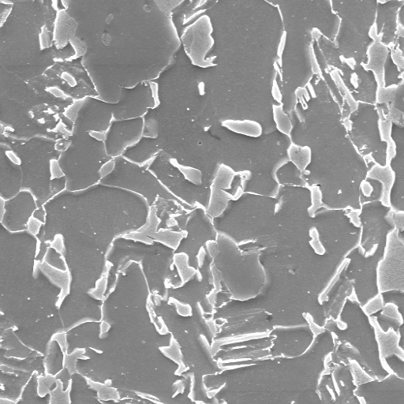
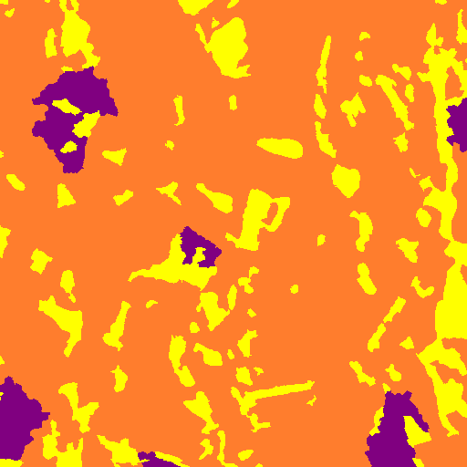

Model Output
Input Test Image
Input Label Image
Output Test Image
Validation mIOU → 0.491552 0.481737
Validation Acc → 97.96 97.44
Test Accuracy → 91.99
Dice Coefficient → 0.922 (avg of 48 test images)
Traning mIoU → 0.494630
Training Acc → 98.91

Slide 3
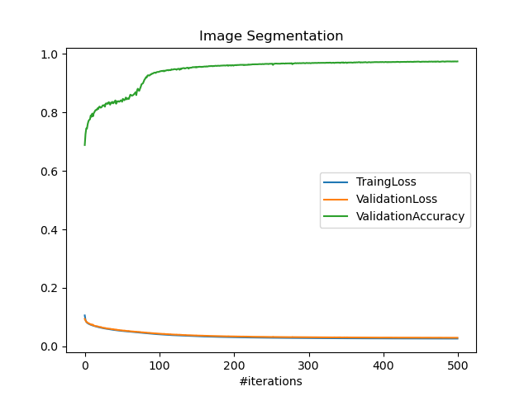
Model Performance

Slide 4
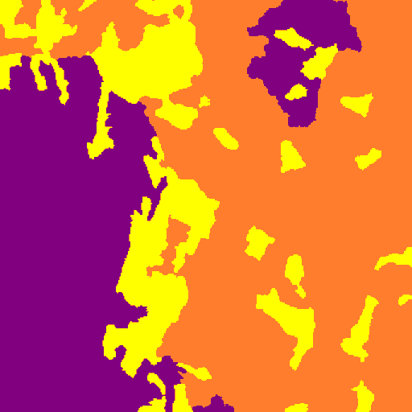
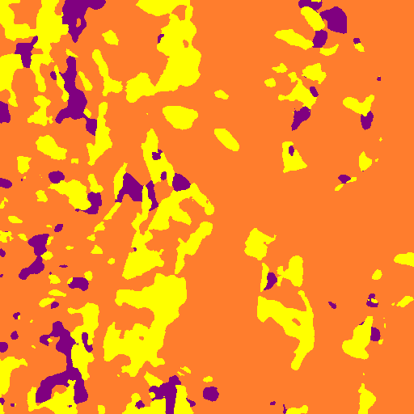
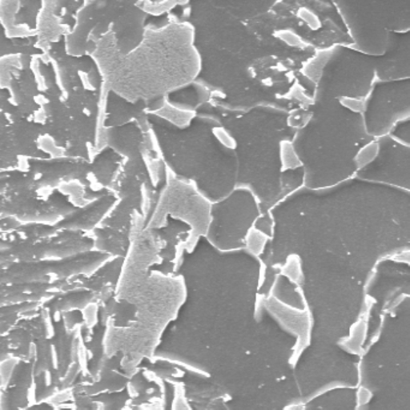
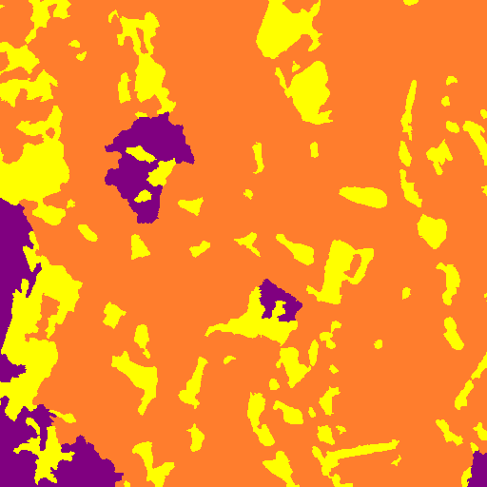
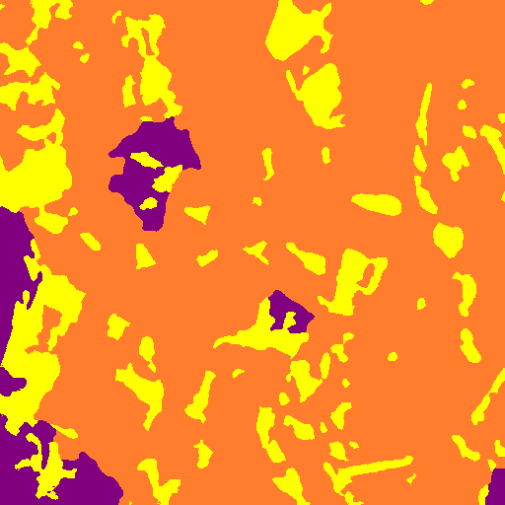
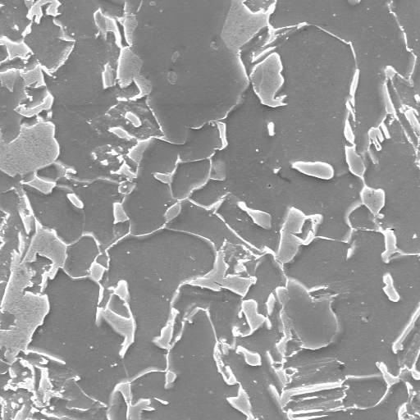
Samples of Test Images
Image having Min. Dice Coefficient → 0.655
Input Test Image
Input Label Image
Output Test Image
Image having Max. Dice Coefficient → 0.99

Slide 5
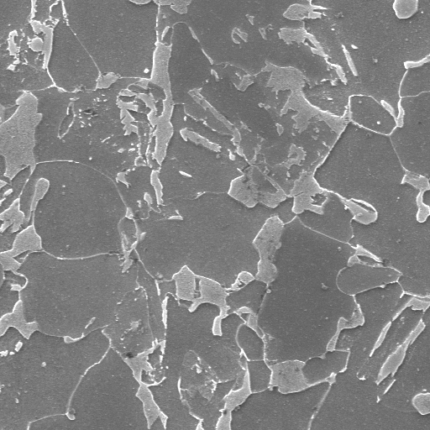
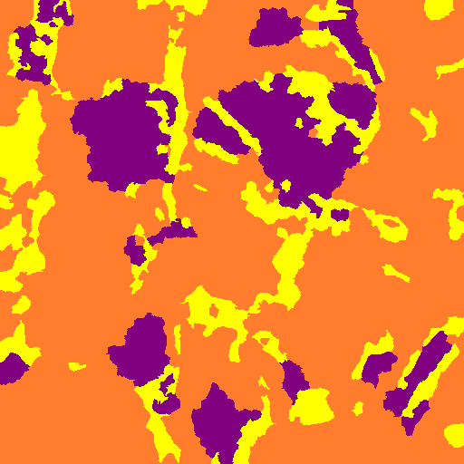
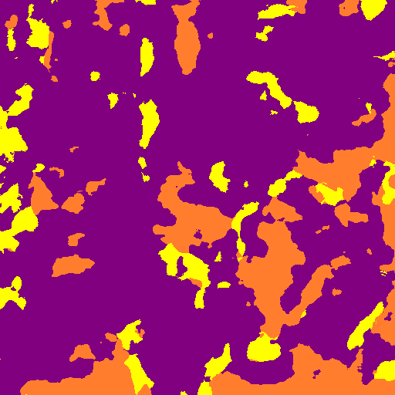
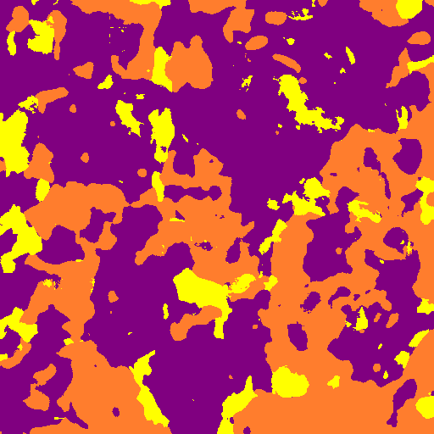
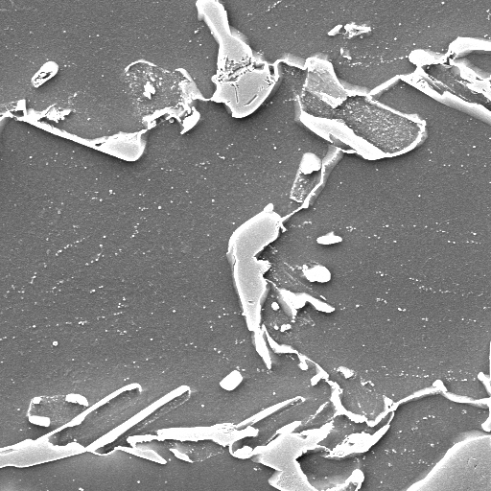
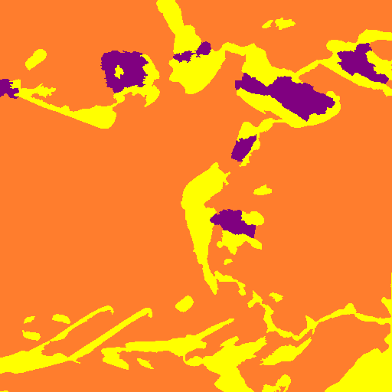
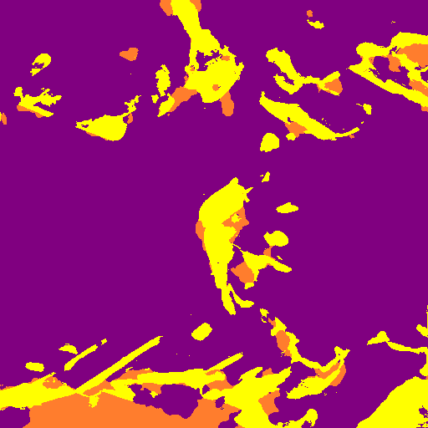
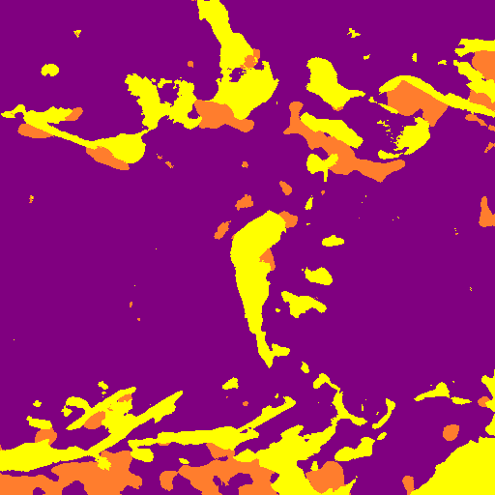
With Magnified Images
Magnified images used as test images for the model trained on original images.
Previous Result
New Result
← x3000 Magnification
images
Dice Coefficient → 0.557 0.411
Dice Coefficient → 0.22 0.22
x5000 Magnification →
images
Previous Result

Slide 6
Observation
There were some performance improvements in the results. But the model still doesn’t do well with magnified images.
The model predicted the lighter patterns in the images more accurately but struggled with gray regions.
Magnification and sliding window augmentation was using to generate images.
While training the model, 15780 images were used as train images, 426 images were used for validation, 48 images were used for testing.

